Slide 1

SQL Injection Attacks

Slide 2
What is SQL Injection?
SQL Injection is a type of cyberattack that targets web applications and their connected databases.
It occurs when an attacker manipulates the input fields or parameters of a web application to inject malicious SQL code into the application's database.
This manipulation allows the attacker to gain unauthorized access to the database, retrieve, modify, or delete data, and potentially execute administrative operations on the database.

Slide 3
How SQL Injection works?
User Input: Many web applications take user input through forms, URL parameters, or cookies. This input is often used in SQL queries to interact with a database. For example, a login form might take a username and password as input.
Lack of Input Validation: Insecure web applications may not properly validate or sanitize user input before using it in SQL queries. Instead, they directly incorporate user input into database queries.
Malicious Input: An attacker exploits this vulnerability by entering malicious input in the form of SQL code. This input can include SQL statements that manipulate the database.

Slide 4
Injection Attack: The application processes the attacker's input as part of a SQL query without properly validating or escaping it. As a result, the SQL code entered by the attacker is executed by the database.
Unauthorized Access: Depending on the specific SQL code injected, the attacker can perform various actions, including:
Bypassing login screens and gaining unauthorized access to the application.
Extracting sensitive data from the database (such as user credentials, personal information, or financial data).
Modifying or deleting data in the database.
Executing administrative operations on the database.

Slide 5
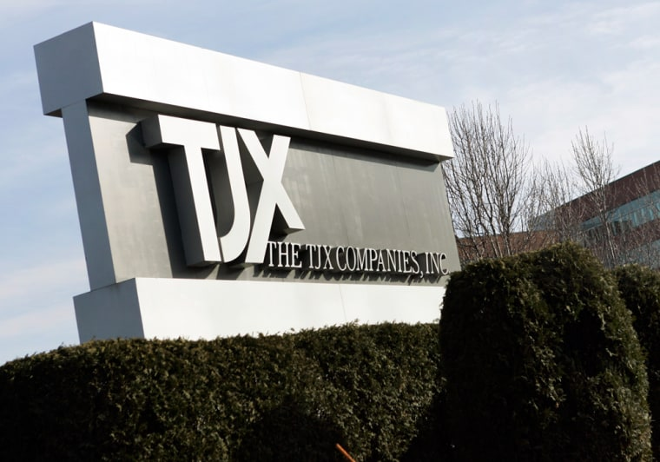
Real world examples of SQL Injections:-
TJX Companies Data Breach (2005):
In one of the largest data breaches at the time,
hackers exploited SQL Injection vulnerabilities
in the wireless networks of TJX Companies,
which owns popular retailers like T.J. Maxx and Marshalls.
Attackers gained access to the company's databases, stealing credit card data and personal information of millions of customers.
The breach went undetected for months, resulting in significant financial losses and damage to TJX's reputation.

Slide 6

Heartland Payment Systems Data Breach (2008):
Hackers used SQL Injection to infiltrate
Heartland Payment Systems, a payment
processing company.
The attackers installed malware on the
company’s network and exfiltrated credit card data from millions of transactions.
This breach led to widespread credit card fraud and significant financial losses for banks and individuals.

Slide 7
Consequences of SQL Injection.
Here are some of the key consequences of SQL Injection:
Data Breaches: SQL Injection attacks can result in unauthorized access to databases, allowing attackers to view, modify, or steal sensitive data. This can include personal information, login credentials, financial records, and more. Data breaches can have significant financial and reputational consequences.
Financial Losses: Organizations may incur financial losses due to SQL Injection attacks. These losses can result from legal fees, regulatory fines, compensation to affected parties, and costs associated with improving security measures.
Reputation Damage: A publicized data breach caused by SQL Injection can severely damage an organization's reputation. Customers and clients may lose trust, and it can take years to rebuild credibility.

Slide 8
4.Identity Theft and Fraud: If personally identifiable information (PII) is exposed, it can lead to identity theft and fraud. Attackers can use stolen data to impersonate individuals, open fraudulent accounts, or commit financial crimes.
5.Business Disruption: SQL Injection attacks can disrupt business operations. For example, if a database is compromised and critical data is lost or manipulated, it can impact daily operations, customer service, and revenue generation.
6.Loss of Intellectual Property: In some cases, SQL Injection attacks can result in the theft of proprietary information, trade secrets, or intellectual property. This can harm a company's competitive advantage and innovation.

Slide 9
Prevention and Mitigation Strategies.
Preventing and mitigating SQL Injection attacks is crucial to protect your web applications and databases from security breaches and their associated consequences. Here are some effective prevention and mitigation strategies:
1. Input Validation and Sanitization:
Validate and sanitize all user inputs, ensuring they adhere to expected data formats and lengths.
Use server-side input validation to reject or sanitize any input that doesn't meet the criteria.
2. Prepared Statements (Parameterized Queries):
Instead of concatenating user inputs directly into SQL queries, use parameterized queries or prepared statements provided by your programming language or database framework.
These methods separate user inputs from SQL code, preventing SQL Injection.

Slide 10
3. Least Privilege Principle:
Apply the principle of least privilege to database accounts. Limit their permissions to only what is necessary for their specific tasks.
Avoid using highly privileged accounts for application connections.
4. Escaping User Inputs:
If parameterized queries or prepared statements are not feasible, escape user inputs by using built-in functions provided by your programming language or framework.
Be cautious when implementing your escape mechanisms, as they can be error-prone.
5. Web Application Firewall (WAF):
Implement a Web Application Firewall to detect and block SQL Injection attempts in real-time.
Configure the WAF to filter and sanitize incoming HTTP requests to block malicious input.

Slide 11
6. Regular Patching and Updates:
Keep your web application server, database server, and all related software up-to-date with the latest security patches.
Vulnerabilities in outdated software can be exploited.
7. Security Audits and Penetration Testing:
Conduct regular security audits and penetration testing of your web applications to identify vulnerabilities, including SQL Injection.
Address and remediate any issues discovered during these assessments.
8. Error Handling and Logging:
Implement proper error handling and logging mechanisms to record and monitor unusual or unexpected behavior.
Avoid exposing detailed error messages to users, which could provide attackers with information about your database structure.

Slide 12
9. Security Education and Training:
Educate your development and IT teams about secure coding practices, including how to prevent SQL Injection.
Promote awareness of security best practices throughout your organization.
10. Security Headers.
11. Web Application Security Frameworks.
12. Implement Two-Factor Authentication (2FA).
By implementing a combination of these prevention and mitigation strategies, you can significantly reduce the risk of SQL Injection attacks and enhance the security of your web applications and databases. Security is an ongoing process, so regular reviews and updates to your security measures are essential.

